Slide 1

STORE SALES PREDICTION
Supervised by: Dr. Misbah Shafi
Submitted by: Arpan Dey (22BEECE04)
Muktai Malekar (22BEECE12)
Manish Kumar (22BEECE13)

Slide 2

Table of Contents:
Introduction
Process flow of progress
Algorithm used
Why Linear Regression?
Generated Data
Final results

Slide 3

Introduction
This presentation focuses on applying machine learning techniques to predict store sales. In today's competitive retail landscape, accurate sales forecasting plays a crucial role in strategic decision-making and resource allocation. Leveraging the vast amounts of available data, machine learning models offer a powerful tool for uncovering patterns and trends within sales data.

Slide 4
Process flow of progress:
Data Collection / Generation
Data Pre-processing
Splitting the data
Training the model
Plotting the results

Slide 5
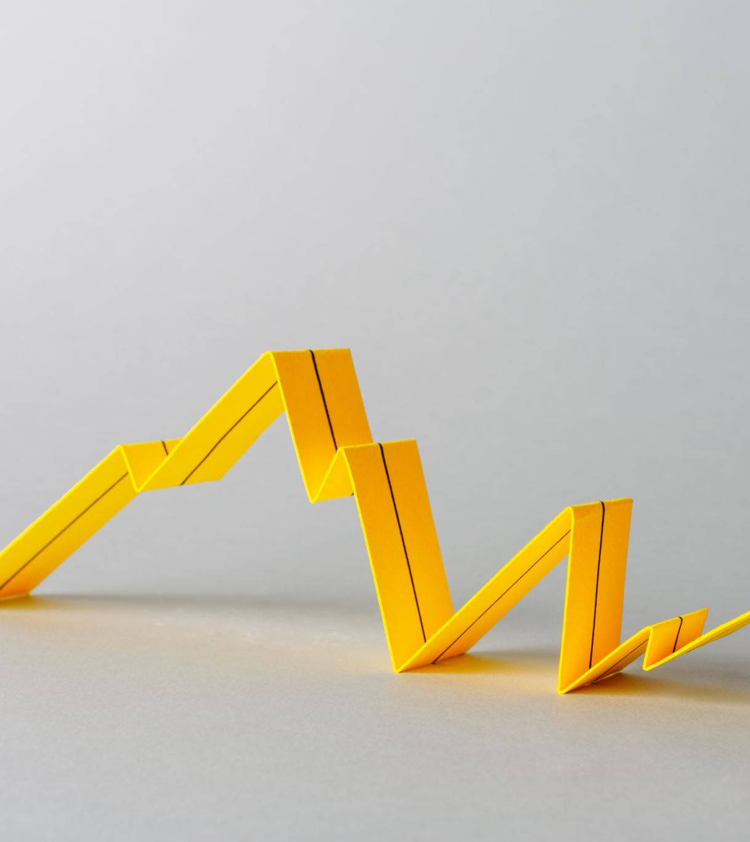
Algorithm used
Linear Regression: Linear regression analysis is used to predict the value of a variable based on the value of another variable. The variable you want to predict is called the dependent variable. The variable you are using to predict the other variable's value is called the independent variable.

Slide 6
Why Linear Regression ?
Interpretability: Coefficients provide clear understanding of feature influence.
Simplicity: Easy to understand, good for beginners.
Efficiency: Computationally efficient for large datasets.
Assumption Checking: Provides framework for validating assumptions.
Feature Importance: Coefficients indicate feature impact on sales.

Slide 7
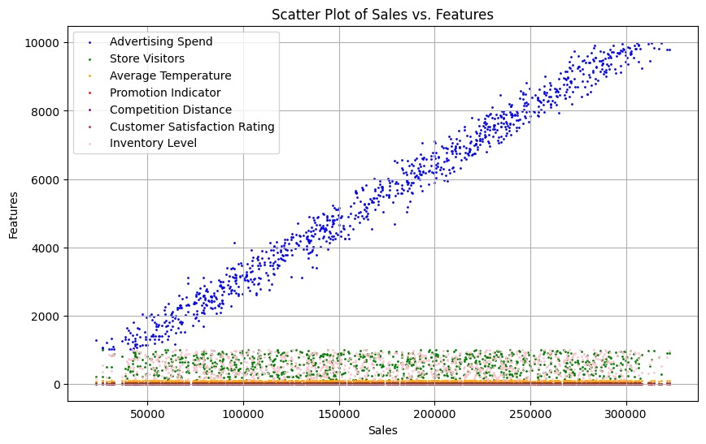
Generated Data:

Slide 8
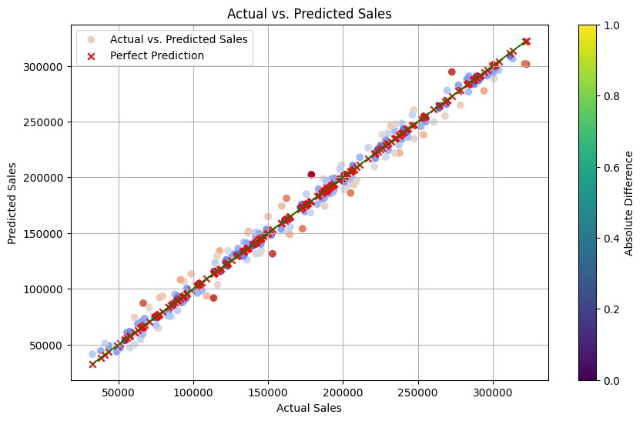
Final Results:
Mean Squared Error: 83178515.39383943
R² Score: 0.9850424572911168

Slide 9
THANK YOU!!!

